Slide 1
Programming for Beginners
COMP 2067
Slides prepared by Dr. Arunita Jaekel
arunita@uwindsor.ca

Slide 2
Basic Programming Concepts
Topics
Variables
Values and data types
Naming variables
Statements
Operations on data
Input/Output
Comments

Slide 3
Computer Organization
CPU
MEMORY
I/O

Slide 4
Variables
Variable: Points to a location in memory that stores a value.
Used to store information to be referenced and manipulated in a computer program.
A variable name is used to refer to an item of data stored in memory.
Helpful to think of labeled containers that hold information (in memory) that can be referenced and used later.
Variable names are like labels used to identify a ‘container’ (memory location).
Suitable variable names makes programs easier to understand.
Variable names are sometimes referred to as identifiers.

Slide 5
Values
Value: An item of data (e.g. a number or a letter or some other data type) that can be stored in a variable or computed in an expression.
Examples: 5, “Hello, World!”, ‘A’
Values can be classified into different classes or data types.
Examples:
5 is an integer (data type: int)
“Hello, World!” and ‘A’ are strings (data type: str), i.e. a string of characters. Strings are enclosed in quotation marks.
You can check the type of an item by using the built-in type function in Python.

Slide 6
Assignment Operator
The = symbol (or assignment operator) is used to assign a value to a variable.
The variable name goes on the left
The value you want to assign goes on the right
Examples
x = 6
y = 7.2
name = ‘Ann’
z = x + y + 2
The assignment operator (=) is NOT the same as the equality operator (==)
= assigns a value
== checks if two things are equal

Slide 7
Assignment Operator
Examples
x = 6
y = 7.2
name = ‘Ann’
z = x + y + 2
x
6
y
7.2
name
‘Ann’
z
15.2
Memory

Slide 8
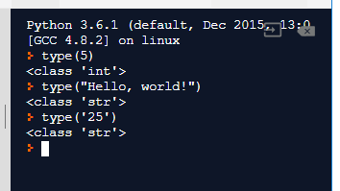
Data Types
You can check the type of an item by using the built-in type function in Python.

Slide 9
Variables
Rules for valid variable names in Python
can contain letters, digits, and the underscore (_), but must begin with a letter or underscore.
Names beginning with underscore often have special meaning. Safer to start variable names in your programs with letters
cannot contain spaces or other special characters ($, /, ?, etc).
cannot use Python reserved kerwords.
Case matters—for instance, temp and Temp are different.
cannot be named after keywords

Slide 10
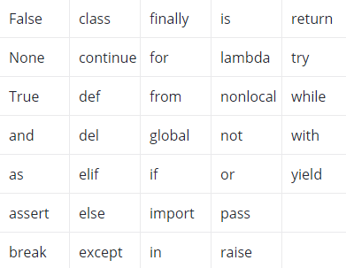
Keywords in Python

Slide 11
Variables
Other guidelines
choose names that are descriptive, but not so long that they clutter up your program
For variables that have multiple words as part of their name, use camelCasing
Invalid variable names result in syntax error.

Slide 12
Python Statements
Instructions that a Python interpreter can execute are called statements.
Example: a = 4 is an assignment statement
Variables and operators work together to create statements.
fruit = ‘apple’
print(fruit)
A variable must first be created with an assignment statement before it can be used in a program.

Slide 13
Python Statements
fruit = ‘apple’
print(fruit)
For statement 1:
Type of statement: assignment statement
What is the variable and what is its value?
variable is: fruit value is: ‘apple’
What is the operator?
=
For statement 2:
Type of statement: function call
What is the variable?
variable is: fruit

Slide 14
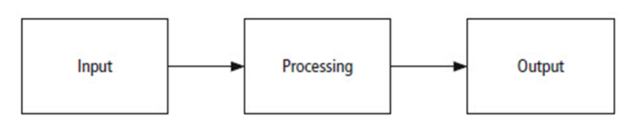
User Input and Output
Python provides a built-in function, called input(), for getting input from the user.
Allows the user to enter a value through the keyboard.
Python provides a built-in function, called print(), for displaying output on the screen.
The output will be displayed in the console window (if using repl.it).

Slide 15
The input Function
Prompts the user to enter data
Message to be displayed is given as a str argument.
User types response, presses ENTER key
The response is returned as a str
Entry assigned to variable on left

Slide 16
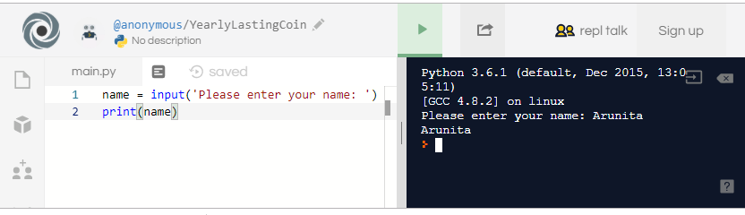
User Input and Output
Example: name = input('Please enter your name: ')
The value typed by the user and assigned to the variable name.
Remember: The input() function always returns a str data type.
Suppose the statement age = input('Please enter your age: ') is run and the user types 22 at the prompt.
This will assign the str '22' to the variable age and not the int 22.
For str values, the print() function does not show the quotation marks.

Slide 17
Internal Documentation
Benefits of documentation
Other people easily understand program.
You can better understand program when you read it later.
Long programs are easier to read
Purposes of individual pieces can be determined at a glance.
Use comments to document your code.

Slide 18
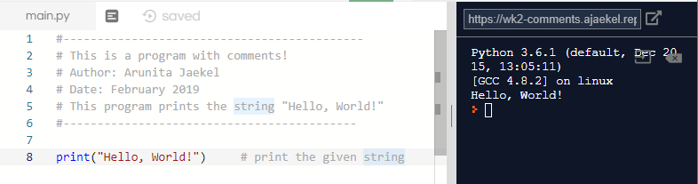
Comments
Comment: Text intended for the human reader.
In Python, the # token starts a comment. The rest of the line is ignored what a section of code does or how it works.
Always include comments in the code you submit for this course, e.g. labs, assignments etc.
For multi-line comments, you can also use triple quotes

Slide 19
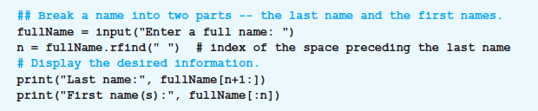
Comments
Example

Slide 20
References
[1] https://en.wikipedia.org/wiki/Computer_program
[2] https://www.britannica.com/technology/computer-program
[3] https://dictionary.cambridge.org/dictionary/english/computer-program
[4] https://whatis.techtarget.com/definition/instruction

